Slide 1
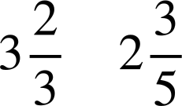
Problem solving with arithmetic procedures involving fractions
Task A: Solving problems involving fractions
1a) A
rectangular
flower bed
has
length
m and
width
m. Jacob wants to plant
flowers in the plot, but needs to buy the compost. The compost bags each cover 1 m² and cost £5.70 per bag. How much will it cost Jacob?
m
Flower bed
m
b) Jacob also needs to put a metal edging around the plot. The edging is sold in 1 m lengths for £3.42 per metre. How much will it cost Jacob to put the edging around the flower bed?
m
Flower bed
m

Slide 2
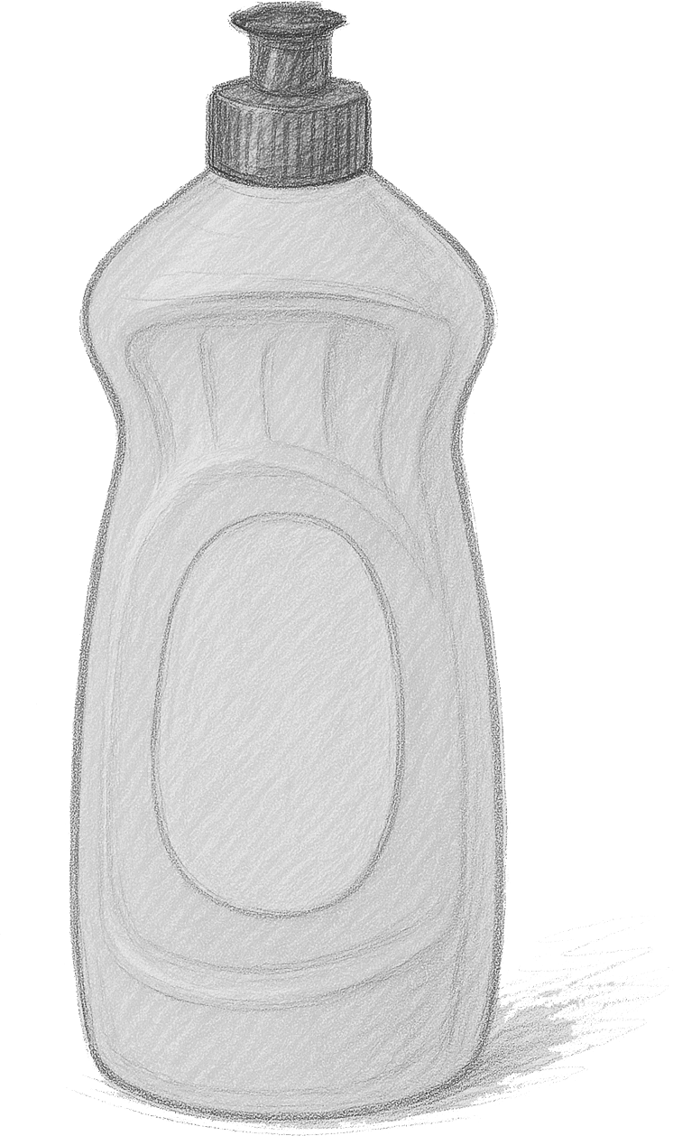

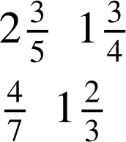
Problem solving with arithmetic procedures involving fractions
For the following question, do not use a calculator and show all your working out.
2) A
bottle
contains
litre of water. On a school trip, three teachers
Teacher A
have a different number of water bottles to give to the students in their groups. Each student gets an equal share.
How much water does each teacher have to share?
How much water do the students in each group get if:
There are three students in Teacher A’s group?
Teacher B
Teacher C
c) There are six students in Teacher B’s group?
d) There are five students in Teacher C’s group?
Task B: Using a calculator
m
Aisha is restoring some old picture frames. She wants to cover the frame in gold leaf.
a) Work out the area of the frame.
b) Gold leaf costs £12.84 per m². How much will it cost Aisha to gold leaf the picture frame?
m
m
m
‹#›

Slide 3
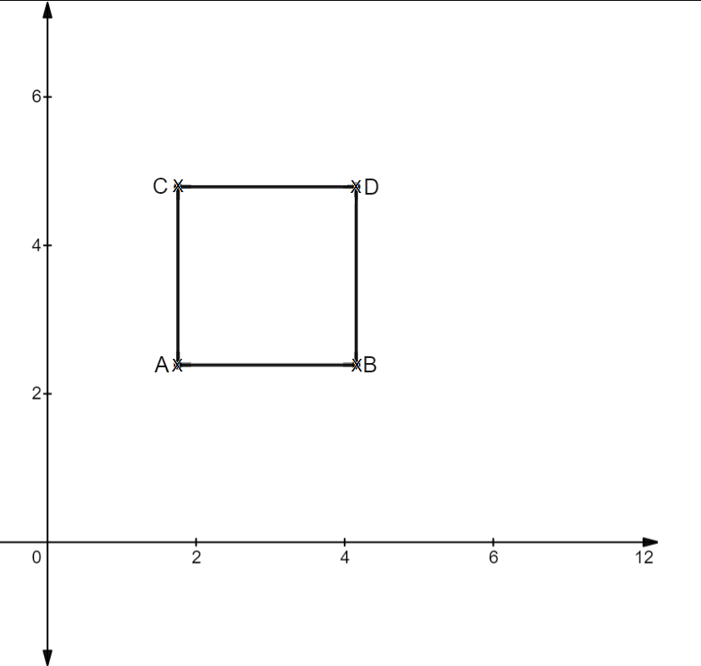
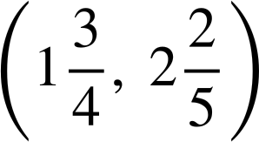
Problem solving with arithmetic procedures involving fractions
2) A
square
with
length
units has been
plotted on an axis.
The coordinate of A is
Write the coordinate of B, C and D, giving your answer as a mixed number.
Mathematics in Education and Industry
v2.1

